Slide 1
Breast Cancer Detection By Using Machine Learning

Slide 2
Team Members :
Yashwanth Sai Reddy
Phanindra
Goutham

Slide 3
Responsibilities:
Yashwanth Sai Reddy:
Worked on Dataset, Data preprocessing, Decision Tree
Phanindra: Worked on Random Forest, Data Visualisation & Documentation.
Mallula Gowtham :
Worked on Dataset, SVM, Ada boost algorithm & Documentation

Slide 4
Motivation :
One of the most prevalent cancers in women and the second leading cause of cancer death in women is breast cancer.
The low diagnostic accuracy is a significant contributor to the high incidence and death of breast cancer, despite the lack of effective treatments. Traditional methods for detecting breast cancer include mammography.
Only 78% of breast cancer cases may be accurately identified by mammography, according to a report from UC Health.

Slide 5
Objectives :
To properly prepare the data for training the machine learning model, clean the data by removing any rows with missing values or null values.
to put into practice and assess the machine learning classification models for the dataset for breast cancer that is being investigated.
We have trained the following machine learning algorithms on the breast cancer dataset:
Support Vector machine
Logistic Regression
K- Nearest neighbors
Random Forest
Naive Bayes

Slide 6
Related Work :
Earlier, research using various data mining approaches was conducted on the categorization and prediction of breast cancer. Information mining employs aggregation and classification frequently.
Furthermore, significant progress has been made in predicting breast cancer survivorship using patient data that has been labeled, unlabeled, and pseudo-labeled.
When it comes to forecasting breast cancer, neural networks and related methods play a significant role.
Numerous breakthroughs have been achieved because to ANNs, including significant advancements in the categorization and early-stage diagnosis of breast cancer.
Input, hidden, and output layers make form the hierarchy of a standard ANN model.

Slide 7
Problem Statement :
Breast cancer, which affects 10% of women globally at various periods of their lives, is one of the most feared and frequently occurring malignancies now impacting women. Despite the fact that this sickness is already treatable in practice in many countries, the main issue emerges when the disease cannot be adequately recognized in the very early stages.
Machine learning has shown to be crucial in this area for forecasting diseases like cancer.

Slide 8
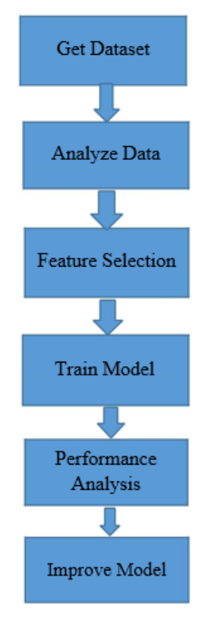
Proposed Solution :
In order to get the most precise forecasts, we have outlined a straightforward model.
Getting a collection of numerical values for diverse situations was the first goal.
In order to train and test six algorithms—Random forest, K-Neighbors, Logistic Regression, Naive Bayes, and Support Vector machine (SVM)—we divided the train-test ratio to 70:30 after finalizing our dataset.
To lessen the dimensionality of the dataset, feature selection in the form of Principal Component Analysis is performed.
The models are retrained using training and testing, and the last step is a comparison of the findings to the earlier results.

Slide 9
Results :
Following the application and implementation of machine learning models, the next stage is to determine the model's effectiveness, or how well it performed on the datasets.
This is done by applying the models to the previously created test dataset.
30% of the dataset for the prediction of breast cancer was included in the test dataset.
We tested six machine learning algorithms: support vector machine, Naive Bayes classifier, KNN classifier, logistic regression, and random forest classifier.

Slide 10
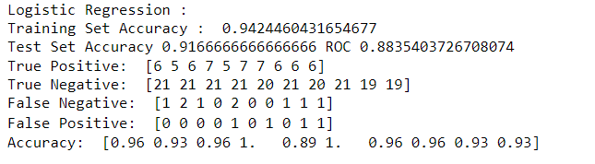
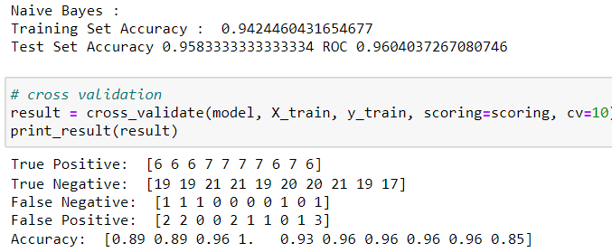

Slide 11
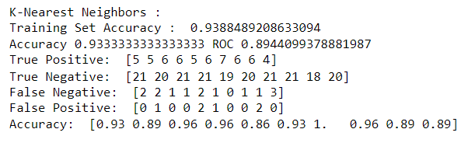
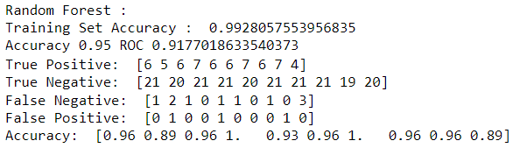
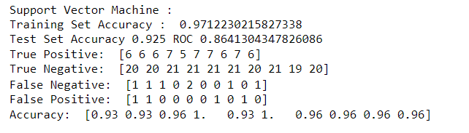

Slide 12
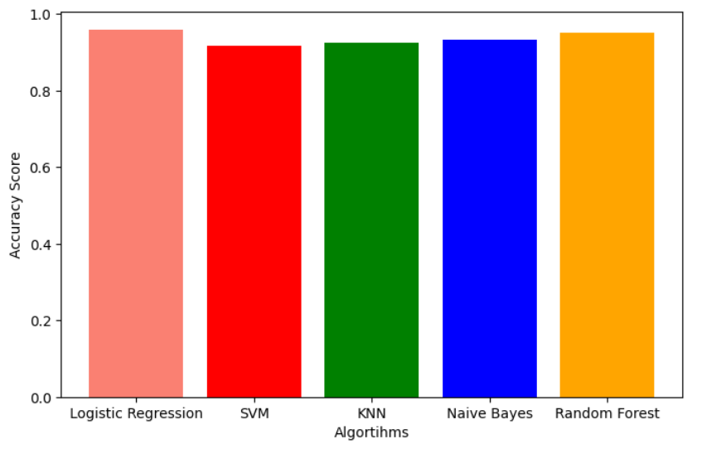
Accuracy Graph For Classifiers

Slide 13
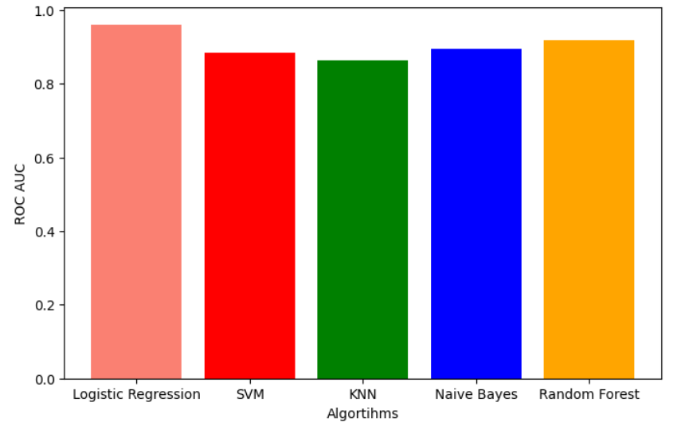
ROC Curves for different classifiers

Slide 14
Conclusion :
The accuracy rating for Naive Bayes is 0.964. Logistic regression (0.923) and K-Nearest Neighbors (0.9349) aren't far behind either. SVM has an accuracy rating of 0.917. Out of the six models, Decision Tree performs the worst, scoring 0.834.
Much may be learned about the performance of the algorithms by taking into consideration the other performance matrices.
K- Neighbors and Naive Bayes exhibit superior performance. Despite reductions in all other performance measures for both the described algorithms, SVM and Logistic Regression both earn a perfect 1.000 for recall, which is crucial for disease prediction.
We can conclude that Support Vector Analysis and Logistic Regression perform better when the recall score is taken into account.

Slide 15
References :
Breast cancer facts and figures 2003-2004 (2003). American Cancer Society
[2] Stages — Mesothelioma — Cancer Research UK Breast cancer survival statistics September 26, 2017
[3] PendharkarPC,RodgerJA,YaverbaumGJ,HermanN,BennerM(1999) Association, statistical, mathematical and neural approaches for mining breast cancer patterns. Expert Systems with Applications 17: 223-232.
[4] deepsense.ai What is reinforcement learning? The complete guide July 05, 2018
[5] Hacker Noon Absolute Fundamentals of Machine Learning – Hacker Noon January 15, 2018
[6] Furundzic, D.; Djordjevic, M.; Bekic, A.J. Neural networks approach to early breast cancer detection. J. Syst. Archit. 1998, 44, 617–633. [CrossRef]
[7] ] Floyd, C.E.; Lo, J.Y.; Yun, A.J.; Sullivan, D.C.; Kornguth, P.J. Prediction of breast cancer malignancy using an artificial neural network. Cancer 1994, 74, 2944–2948. [CrossRef]
[8] H. A. Abbass, “An evolutionary artificial neural networks approach fo
[9] J. Khan, J. S. Wei, M. Ringne ́r, L. H. Saal, M. Ladanyi, F. Westermann, F. Berthold, M. Schwab, C. R. Antonescu, C. Peterson, and P. S. Meltzer, “Classification and diagnostic prediction of cancers using gene expression profiling and artificial neural networks.,” Nat. Med., vol. 7, no. 6, pp. 673–9, Jun. 2001.
[10] G.-B. Huang, Q.-Y. Zhu, and C.-K. Siew, “Extreme learning machine: Theory and applications,” Neurocomputing, (Dec. 2006.) vol. 70, no. 1–3, pp. 489–501.

Slide 16
C. P. Utomo, A. Kardiana, and R. Yuliwulandari, “Breast Cancer Diagnosis using Artifi-cial Neural Networks with Extreme Learning Techniques,” Int. J. Adv. Res. Artif. Intell, vol. 3, no. 7,pp. 10–14,
[12] Fine Needle Aspiration Biopsy of the Breast. American Cancer Society.
[13] Friedman, Jerome, Trevor Hastie, and Rob Tibshirani. Regularization paths for generalized linear models via coordinate descent.” Journal of statistical software 33.1 (2010): 1
[14] Rohith Gandhi. Nearest Neighbor. Understanding Machine Learning (2018)
[15] MachineLearningMasteryDiscriminantAnalysisforMachineLearning September 22, (2016)
[16] G.-B. Huang, Q.-Y. Zhu, and C.-K. Siew, “Extreme learning machine: Theory and applications,” Neurocomputing, (Dec. 2006.) vol. 70, no. 1–3, pp. 489–501.
[17] C. P. Utomo, A. Kardiana, and R. Yuliwulandari, “Breast Cancer Diagnosis using Artifi-cial Neural Networks with Extreme Learning Techniques,” Int. J. Adv. Res. Artif. Intell, vol. 3, no. 7, pp. 10–14
[18] William H Wolberg, W Nick Street, and Olvi L Mangasarian. (1992). Breast cancer Wisconsin (diagnostic) data set. UCI Machine Learning Repository.
[19] H. A. Abbass, “An evolutionary artificial neural networks approach for breast cancer diagnosis.” Artif.Intell. Med., vol. 25, no. 3, pp. 265–81,
[20] J. Khan, J. S. Wei, M. Ringne ́r, L. H. Saal, M. Ladanyi, F. Westermann, F. Berthold, M. Schwab, C. R. Antonescu, C. Peterson, and P. S. Meltzer, “Classification and diagnostic prediction of cancers using gene expression profiling and artificial neural networks.,” Nat. Med., vol. 7, no. 6, pp. 673–9

